Slide 1
4:1-11

Slide 2
4:1-11
1 Timothy 4:1–11 ~ ¹ Now the Spirit expressly says that in latter times some will depart from the faith, giving heed to deceiving spirits and doctrines of demons, ² speaking lies in hypocrisy, having their own conscience seared with a hot iron, ³ forbidding to marry, and commanding to abstain from foods which God created to be received with thanksgiving by those who believe and know the truth. ⁴ For every creature of God is good, and nothing is to be refused if it is received with thanksgiving; ⁵ for it is sanctified by the word of God and prayer.
⁶ If you instruct the brethren in these things,

Slide 3
4:1-11
1 Timothy 4:1–11 ~ you will be a good minister of Jesus Christ, nourished in the words of faith and of the good doctrine which you have carefully followed. ⁷ But reject profane and old wives’ fables, and exercise yourself toward godliness. ⁸ For bodily exercise profits a little, but godliness is profitable for all things, having promise of the life that now is and of that which is to come. ⁹ This is a faithful saying and worthy of all acceptance. ¹⁰ For to this end we both labor and suffer reproach, because we trust in the living God, who is the Savior of all men, especially of those who believe. ¹¹ These things command
and teach.

Slide 4
4:1-11

Slide 5
4:1-11
Acts 20:29-30 ~ ²⁹ For I know this, that after my departure savage wolves will come in among you, not sparing the flock. ³⁰ Also from among yourselves men will rise up, speaking perverse things, to draw away the disciples after themselves.
Matt. 24:3b ~ “Tell us, when will these things be? And what will be the sign of Your coming,”
Matt. 24:12 ~ “And because of lawlessness the love of many will grow cold.”

Slide 6
4:1-11

Slide 7
4:1-11
Doorways to apostacy:
Pragmatism ~
“‘If it works, that must be God blessing it.’ So stated, no intelligent Christian would endorse this motto.” – James F. Sennett
“If I experience it, it must be from God.”
Existentialim (or, Experientialism) ~
contains
contains
“The Bible the word of God”
Liberalism ~

Slide 8
4:1-11
Doorways to apostacy:
New revelations ~
“It’s difficult to expect the same fruit of the early church when we value a book they didn’t have more than the Holy Spirit they did have. It’s not Father, Son and Holy Bible.” – (name withheld)
“The Bible is not a roadmap, it’s a compass.” – (name withheld)

Slide 9
4:1-11
Doorways to apostacy:
Apathy ~
“Renewing the mind begins with repentance … ‘re’ means to ‘go back.’ ‘Pent’ is like the penthouse, the top floor of a building. ‘Repent’ then, means to go back to God’s perspective on reality.” – (name withheld)

Slide 10
4:1-11
Doorways to apostacy:
Apathy ~
“Psalm 37:4 tells us: ‘Delight yourself in the Lord, and He shall give you the desires of your heart.’ That verse literally means that God wants to be impacted by what you think and dream. God is after your desires. The word desire is made up of the prefix ‘de’ meaning ‘of,’ and ‘sire’ meaning ‘father.’ Desire is, by nature, of the Father.” – (name withheld)

Slide 11
4:1-11

Slide 12
4:1-11
Winston Churchill ~ “The most powerful thing in the world is the truth, in fact, it is so valuable that it is often covered by a bodyguard of lies.”

Slide 13
4:1-11

Slide 14
4:1-11
seared ~ kauthēriazō – cauterize

Slide 15
4:1-11

Slide 16
4:1-11
Unity
Discernment
1 Cor. 1:10
1 Tim. 6:4-5
John 17:22-23
Matt. 7:15-16a
Eph. 4:1-3
Gal. 1:7b-8
2 Cor. 3:11
Rom. 16:17-18
1 Tim. 6:4-5 ~ ⁴ (a false teacher) is proud, knowing nothing, but is obsessed with disputes and arguments over words, from which come envy, strife, reviling, evil suspicions, ⁵ useless wranglings of men of corrupt minds and destitute of the truth, who suppose that godliness is a means of gain. From such withdraw yourself.
2 Cor. 13:11 ~ Finally, brethren, farewell. Become complete. Be of good comfort, be of one mind, live in peace; and the God of love and peace will be with you.
Gal. 1:7b-8 ~ ^{7b} but there are some who trouble you and want to pervert the gospel of Christ. ⁸ But even if we, or an angel from heaven, preach any other gospel to you than what we have preached to you, let him be accursed.
1 Cor. 1:10 ~ Now I plead with you, brethren, by the name of our Lord Jesus Christ, that you all speak the same thing, and that there be no divisions among you, but that you be perfectly joined together in the same mind and in the same judgment.
Matt. 7:15-16a ~ ¹⁵ “Beware of false prophets, who come to you in sheep's clothing, but inwardly they are ravenous wolves. ^{16a} You will know them by their fruits.”
Rom. 16:17-18 ~ ¹⁷ Now I urge you, brethren, note those who cause divisions and offenses, contrary to the doctrine which you learned, and avoid them. ¹⁸ For those who are such do not serve our Lord Jesus Christ, but their own belly, and by smooth words and flattering speech deceive the hearts of the simple.
John 17:22-23 ~ ²² And the glory which You gave Me I have given them, that they may be one just as We are one: ²³ I in them, and You in Me; that they may be made perfect in one, and that the world may know that You have sent Me, and have loved them as You have loved Me.
Eph. 4:1-3 ~ I, therefore, the prisoner of the Lord, beseech you to walk worthy of the calling with which you were called, ² with all lowliness and gentleness, with longsuffering, bearing with one another in love, ³ endeavoring to keep the unity of the Spirit in the bond of peace.

Slide 17
4:1-11

Slide 18
4:1-11
Gen. 11:6 ~ And the Lord said, “Indeed the people are one and they all have one language, and this is what they begin to do; now nothing that they propose to do will be withheld from them.”

Slide 19
4:1-11

Slide 20
4:1-11
instruct ~ hupotithēmi – to lay or place under
NIV ~ point out – i.e. stepping stones
minister ~ diakonos (be a good servant, not be a good pastor)
doctrine ~ didaskalia – 1st of 3x in chapter (vv. 13 & 16)

Slide 21
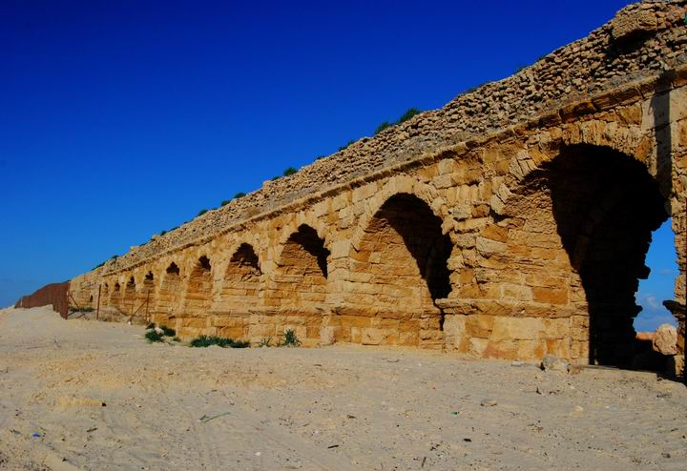
4:1-11
6” in 12 miles

Slide 22
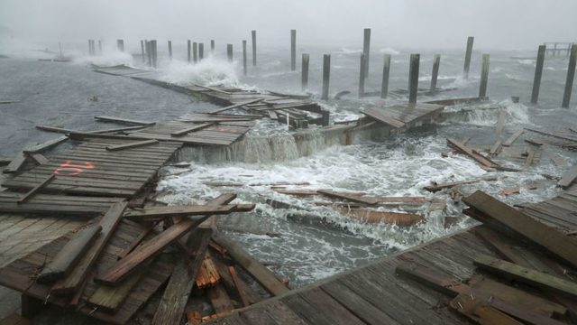
4:1-11

Slide 23
4:1-11

Slide 24
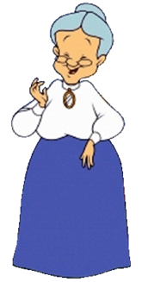
4:1-11
fables ~ muthos (myths)
If you
make silly faces, it will make your face freeze and become permanent
If you
eat ice cream before you go to bed you will have nightmares
If you swallow your gum it will stay in your stomach 7 years

Slide 25
4:1-11

Slide 26
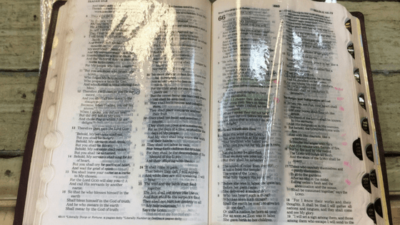
4:1-11

Slide 27
4:1-11
2 Thess. 2:9-10 ~ ⁹ The coming of the lawless one is according to the working of Satan, with all power, signs, and lying wonders, ¹⁰ and with all unrighteous deception among those who perish, because they did not receive the love of the truth, that they might be saved.

Slide 28
4:1-11

Slide 29
4:1-11
exercise ~ gumnasia (gymnasium)

Slide 30
4:1-11

Slide 31
4:1-11
Savior ~ sōtēr– one who saves, delivers or a preserves
Preserver of all men

Slide 32
4:1-11

